Slide 1
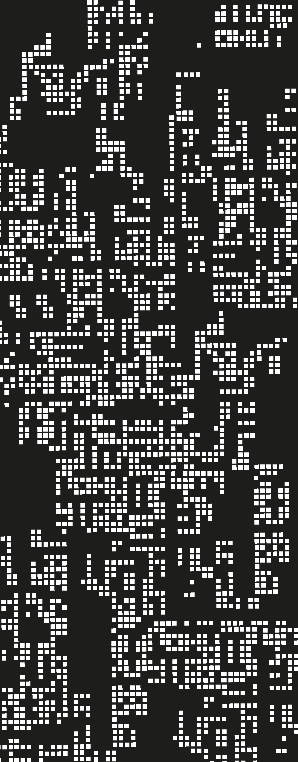
Data Challenge DSW 2023
Team: Data Jester

Slide 2
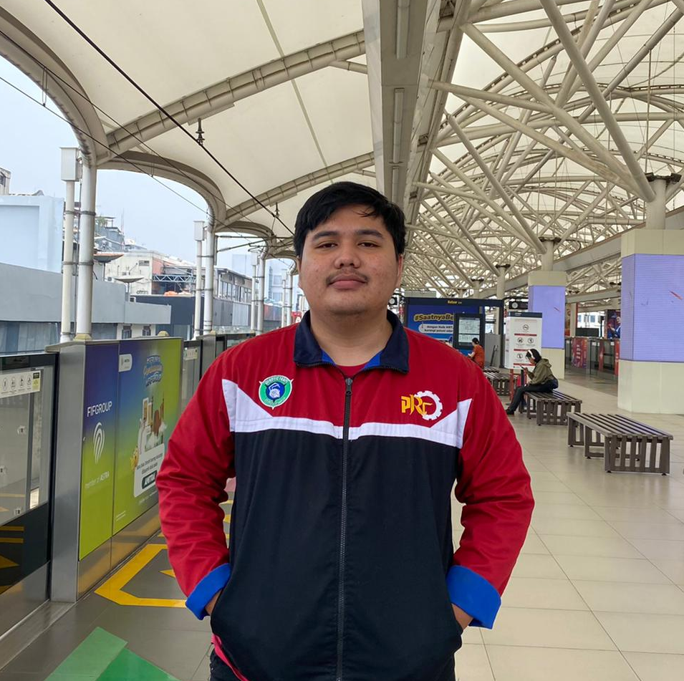
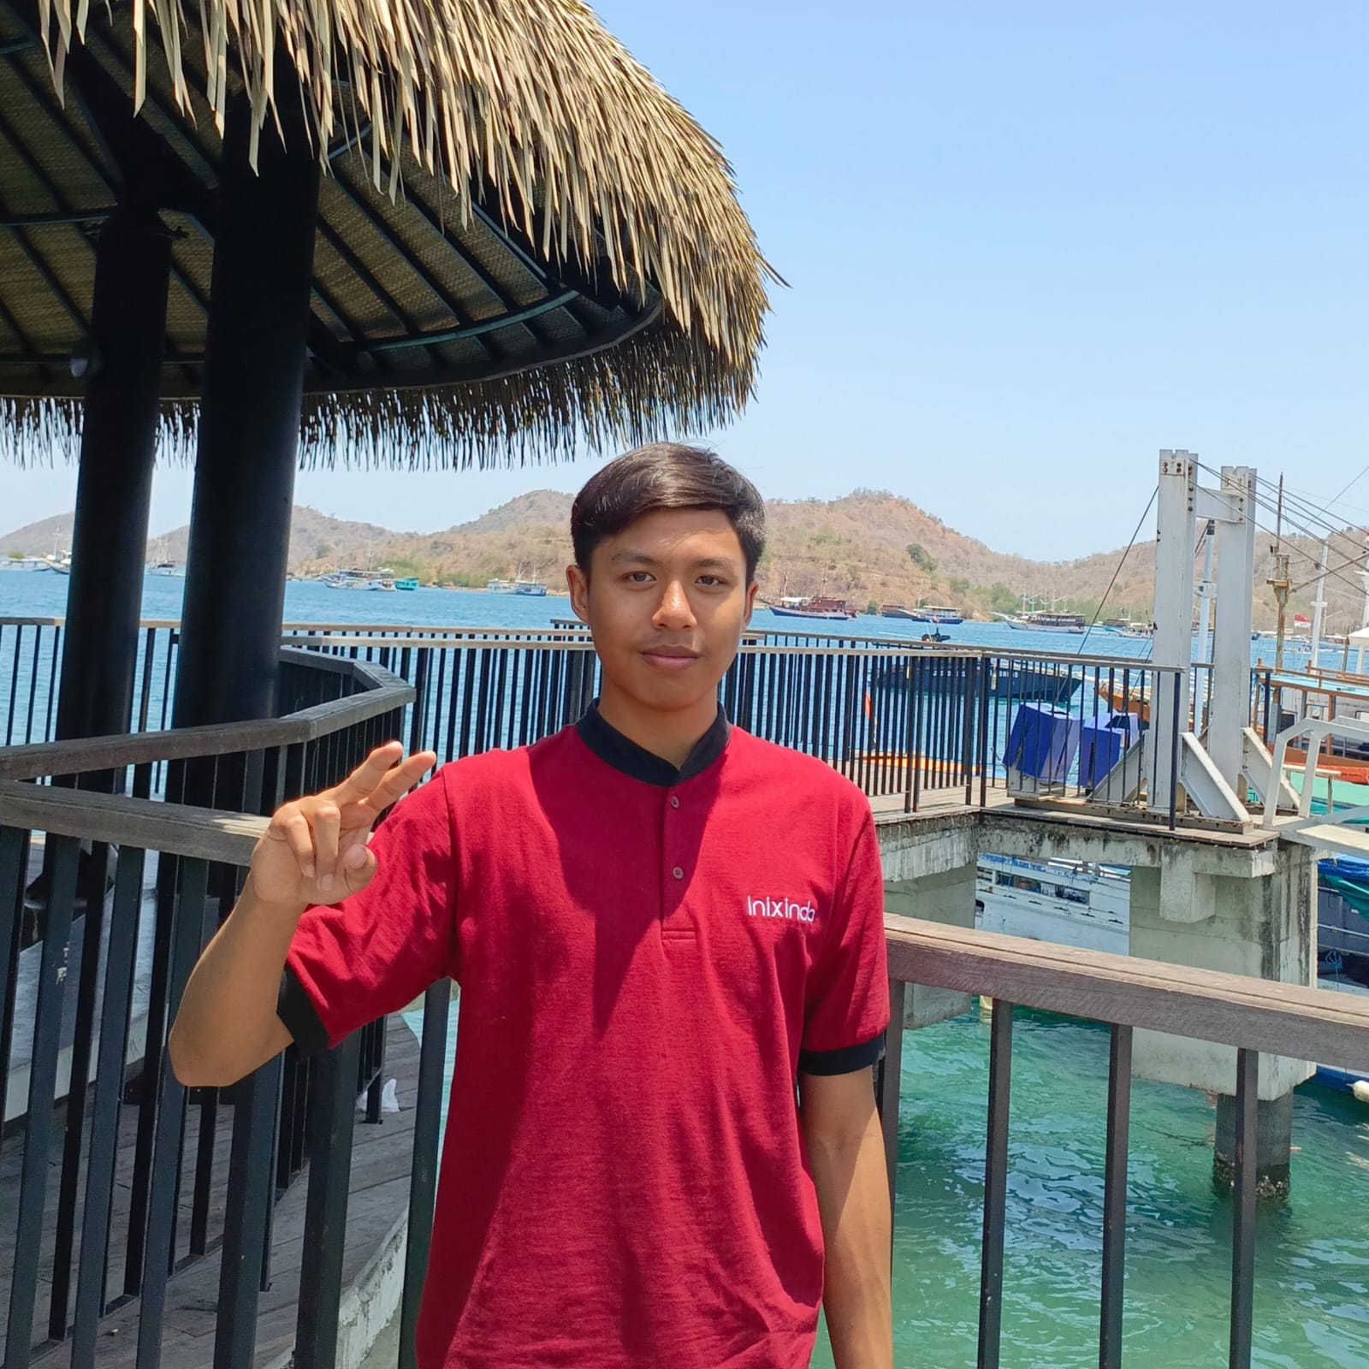
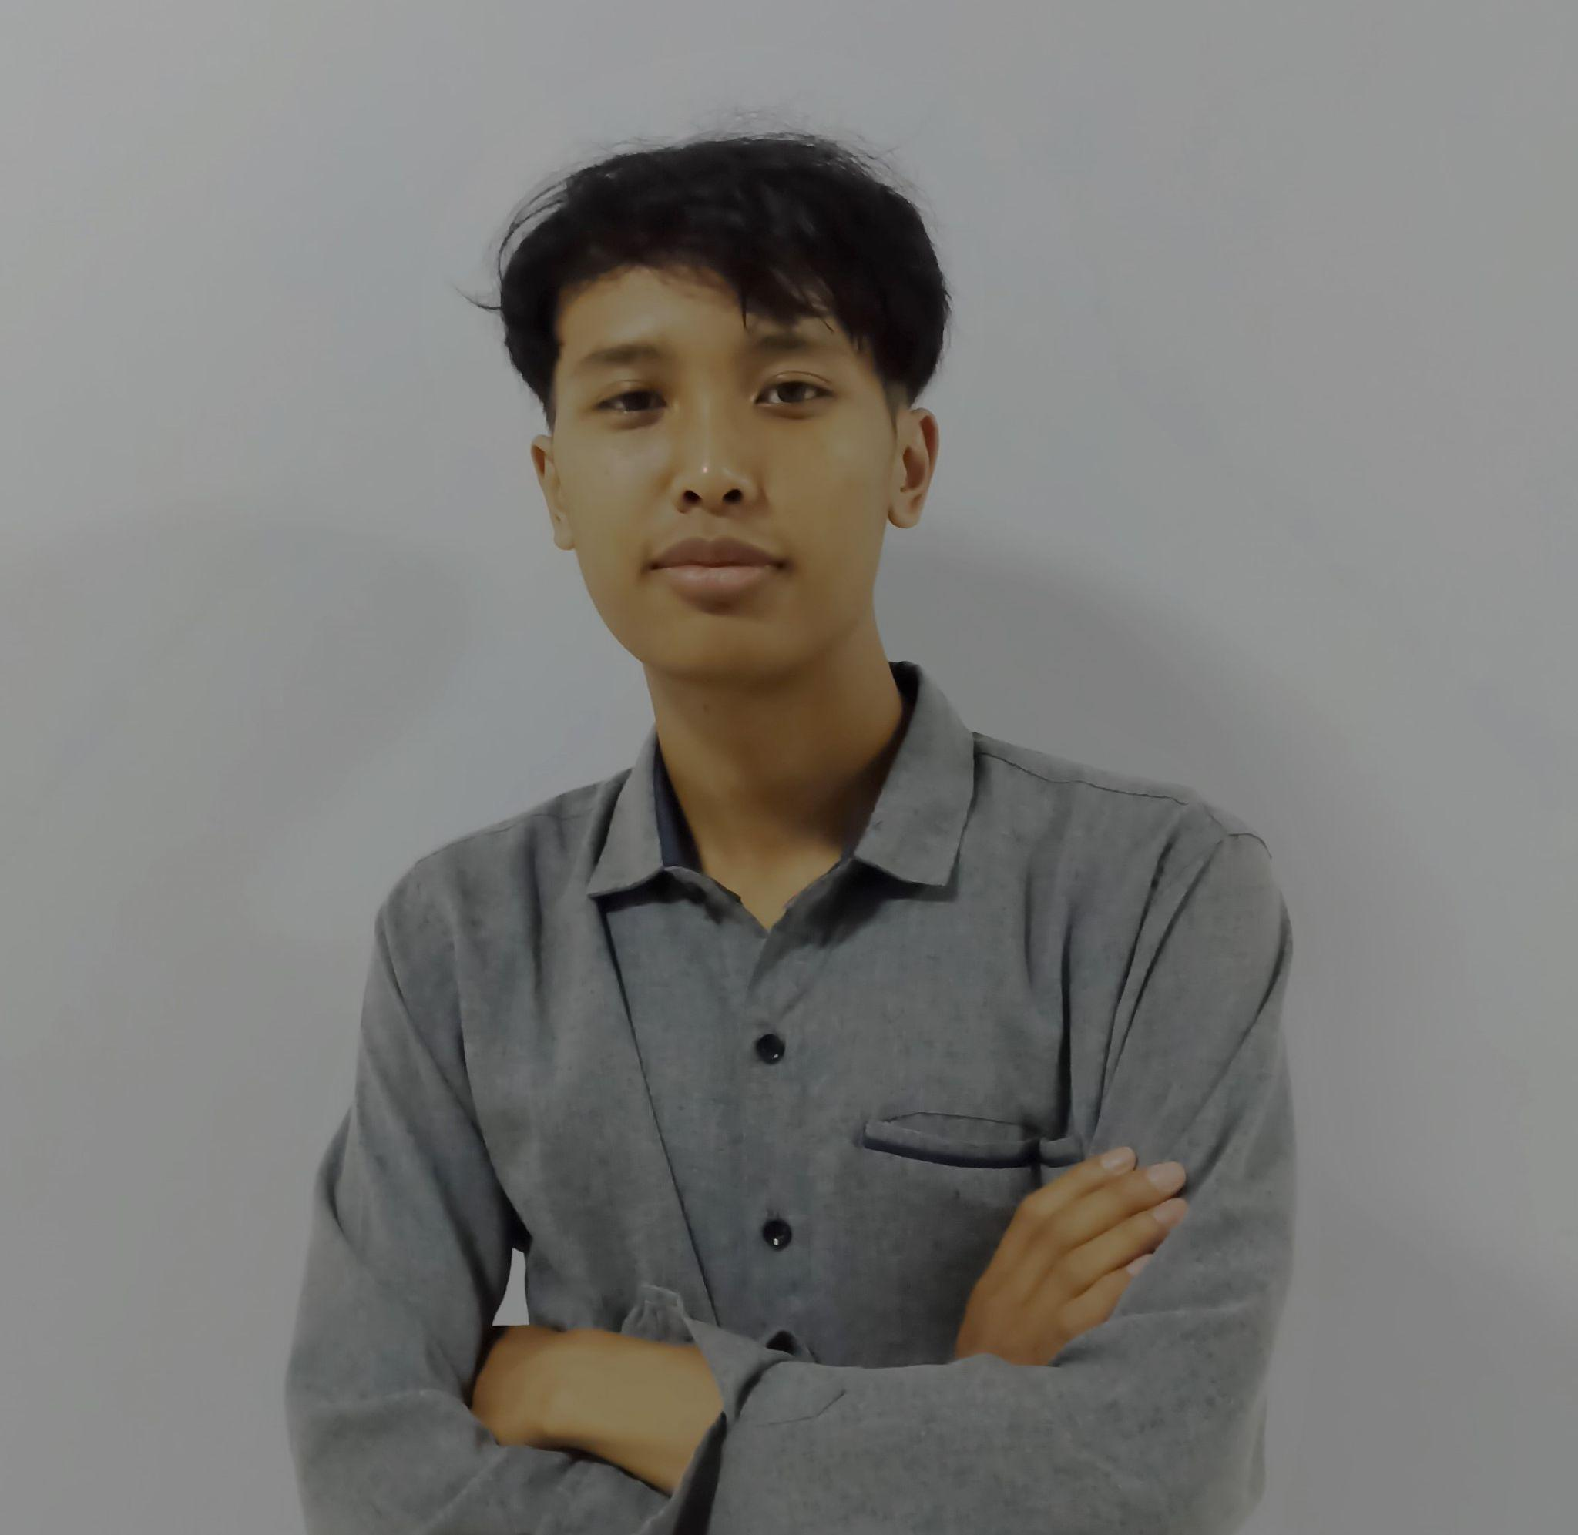
Data Jester Team
Ketua Tim
Member 1
Member 2
Andi Dwi Prastyo
NIM: 2141720046
Mochammad Zaky Zamroni
NIM:
2141720173
Ziedny Bisma Mubarok
NIM: 2141720117

Slide 3
Table of contents
01
Introduction
02
Data and Methodology
03
Result
04
Conclusion

Slide 4
Introduction
01

Slide 5
Unleashing Data Dynamics for Enhanced Customer Experiences
In a highly competitive telecom landscape, our client, a key industry player, is determined to reshape customer experiences. With a robust dataset covering varied customer interactions—call records, data usage, and service interactions—the company is poised for actionable insights and a strategic dive into customer behavior patterns.
Committed to service excellence, churn reduction, and personalized offerings, the telecom company embraces a data-driven revolution. By integrating advanced analytics and artificial intelligence, this initiative not only decodes historical trends but forecasts future behaviors. The objective is clear: forge a proactive strategy that aligns with evolving customer needs, placing our client at the forefront of innovation in the dynamic telecom landscape.

Slide 6
Data and Methodology
02

Slide 7
Data and Methodology
The dataset captures Q3 telecommunication service usage, encompassing vital information such as Tenure Months, Location, Device Class, and indicators for Games, Music, Education, Call Center, Video, and MyApp services. Additionally, it includes details like Payment Method, Monthly Purchase, Churn Label, Longitude, Latitude, and Customer Lifetime Value (CLTV). This comprehensive dataset serves as a foundation for meaningful analysis to enhance services and improve customer satisfaction.
To delve into customer behavior analysis, an innovative solution involves the creation of an artificial neural network model. Leveraging the dataset, this model is trained to predict crucial metrics, such as churn probability, service utilization, or customer satisfaction. The adaptive nature of the neural network enables it to discern intricate patterns within the data, providing valuable insights. These insights, derived from the neural network's analysis, serve as a dynamic tool for the telecommunication company to optimize services and elevate the overall customer experience.

Slide 8
Data
The datasets consists of many features, such as :
The Telco Products feature indicates the products offered by the Telco company, such as Video, Music, and Education. These features have binary values (Yes/No) indicating whether users purchase these products or not.
User locations, represented by the Longitude, and Latitude features, specify the geographical coordinates of users, located in Bandung and Jakarta.
The Device Class categorizes users into segments based on their device types i.e. High-end, Mid-end, and Low-end.
Tenure Months represent the number of months users have been using Telco products at the end of the quarter.
Payment Methods denote the various payment modes employed by users in transactions.
Churn Label serves as a label for users who are still subscribed to Telco services.
Call Center signifies whether users utilize the call center service.
Use MyApp indicates the usage of the MyApp feature.
Monthly Purchase reflects the total expenditure made by users per month.
This is the main metric representing the total expected revenue from a customer over their entire relationship with the company.

Slide 9
Data
The datasets consists of many features, such as :
The Telco Products, fitur ini menunjukan produk-produk yang ditawarkan oleh perusahaan Telco seperti Video, Music, dan Education. Fitur-fitur ini memiliki nilai berupa Yes dan No yang menunjukan apakah para pengguna membeli produk ini atau tidak.
Lokasi para pengguna, pada fitur Location, Longitude dan Latitude menjelaskan lokasi dari para pengguna yang mana terletak di Bandung dan Jakarta
Device Class, membagi user menjadi beberapa segmen berdasarkan device yang mereka miliki yaitu High-end, Mid-end, dan Low-end
Tenure Months, berapa bulan para user menggunakan produk Telco di akhir kuartal
Payment Methods, metode pembayaran yang digunakan user dalam transaksi dan pembayaran
Churn Label, label yang disematkan pada user yang masih berlangganan pada Telco
Call Center, apabila user menggunakan call center atau tidak
Use MyApp, apabila user menggunakan MyApp atau tidak
Monthly Purcahse, total pengeluaran yang dikeluarkan oleh para user per bulan
This is the main metric representing the total expected revenue from a customer over their entire relationship with the company.

Slide 10
Methodology
The steps in the analysis method carried out are as follows:
Removal of unnecessary columns, namely Customer ID, Longitude, and Latitude.
Examination of unique values, followed by cleansing operations such as converting 'No internet service' to 'No.'
Implementation of encoding, feature selection, and standardization processes.
Visualization of correlations between data.
Lastly, the Neural Network modeling process.
Streamlining the dataset by addressing categorical values, conducting essential preprocessing, and visualizing feature interactions. The last step entails building an Artificial Neural Network model for deriving insights and predictions from the refined dataset.

Slide 11
Result
03

Slide 12
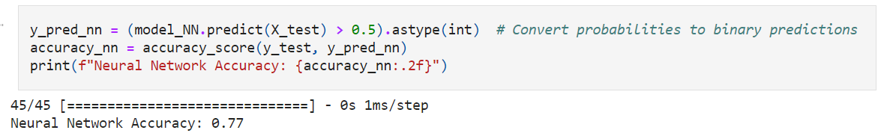
Result
After training the Neural Network model with 25 epochs. The Neural Network model that was created received an accuracy score of 77%

Slide 13
Conclusion
04

Slide 14
Conclusion
After conducting neural network modeling, the solution is identified as follows:
From the correlation heatmap, it can be observed that music product, education product, and video product significantly influence customers' monthly expenditures, predominantly influenced by the use of MyApp. MyApp facilitates transactions, leading to increased monthly expenditures by customers.
A 77% accuracy suggests that the model is capturing patterns within the data effectively, particularly regarding the influence of music, education, and video products on customer expenditures facilitated by MyApp.

Slide 15
Thanks!
Thank you for your attention

